Slide 1
The Napoleonic Wars
1803-1815

Slide 2
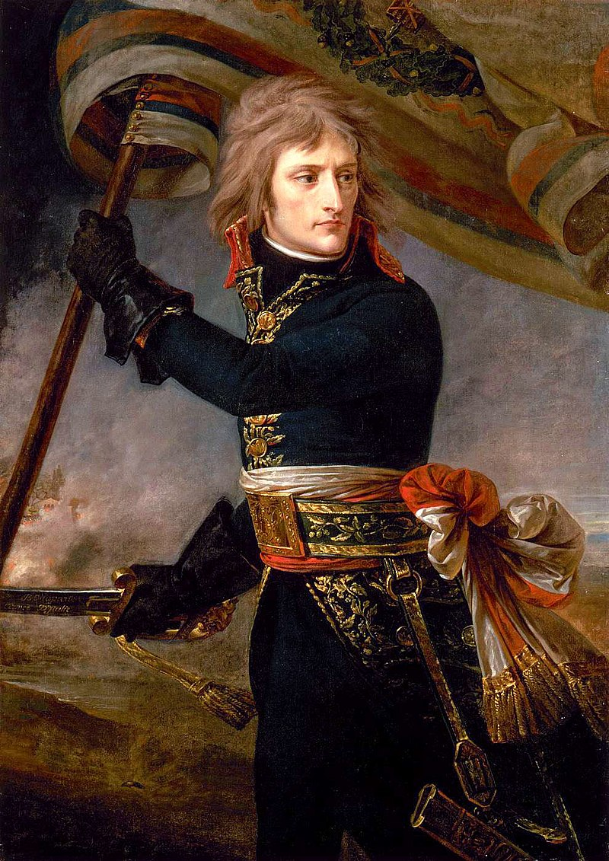
Napoleon Bonaparte
Napoleon Bonaparte was descended from Italian nobility and grew up in Corsica, an island off the coast of Southern France and Northern Italy
His father had been the Corsican representative to the French Court and Napoleon was born the same year that Corsica became a French possession (1769)
His first languages were Corsican and Italian and he spoke French with a distinctive Corsican accent
In 1784 he was admitted to the French Military Academy in Paris where he specialized as an artillery officer

Slide 3
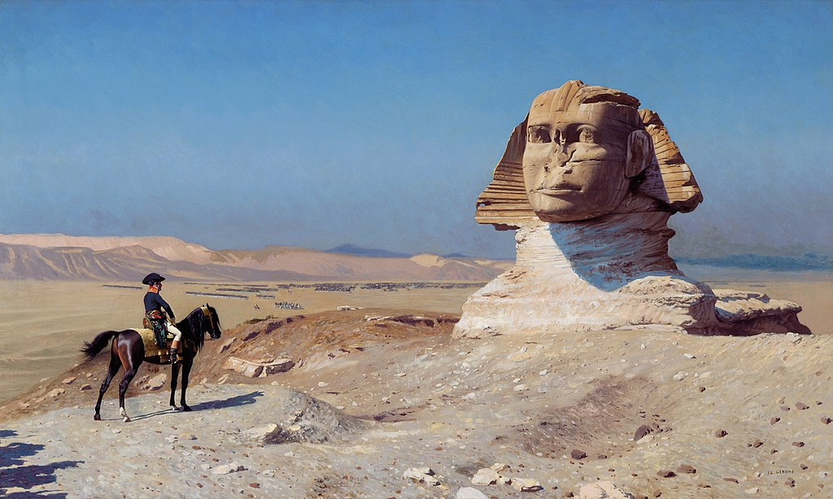
Napoleon Bonaparte
During the French Revolution he organized Jacobin clubs in Corsica
During a Royalist insurrection in 1795, Napoleon reached sudden fame when he extinguished the enemy with “a whiff of grapeshot”
The Directory, the government at the time, used his popularity for their own benefit
With the Directory’s blessing Napoleon began his conquests of Malta, Egypt, and Italy.

Slide 4


Slide 5
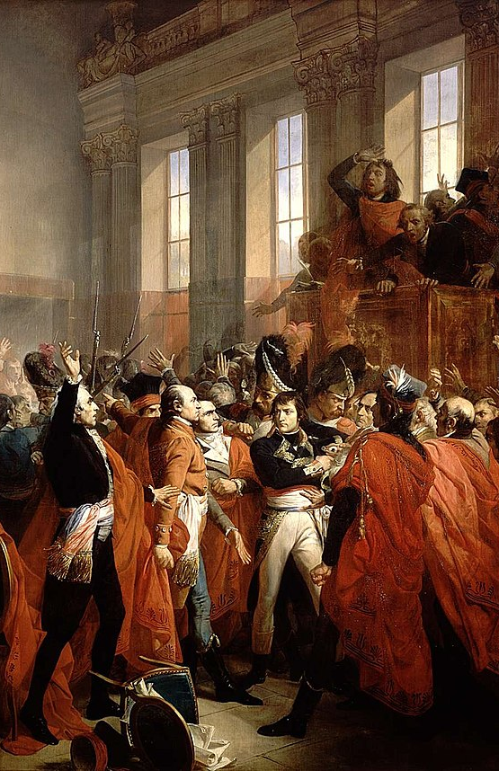
First Consul
While being absent in Egypt and the Middle East, France lost of series of battles called the War of the Second Coalition
Napoleon returned to France and within three months had overthrown the government on November 9, 1799 (the 18 Brumaire).
He named himself First Consul, a position that was supposed to be held for ten years.
The political system he established was essentially a dictatorship.
After an audacious campaign in which he and his troops crossed over the Alps, Napoleon’s France won the War of the Second Coalition with the Treaty on Lunéville in 1801.

Slide 6
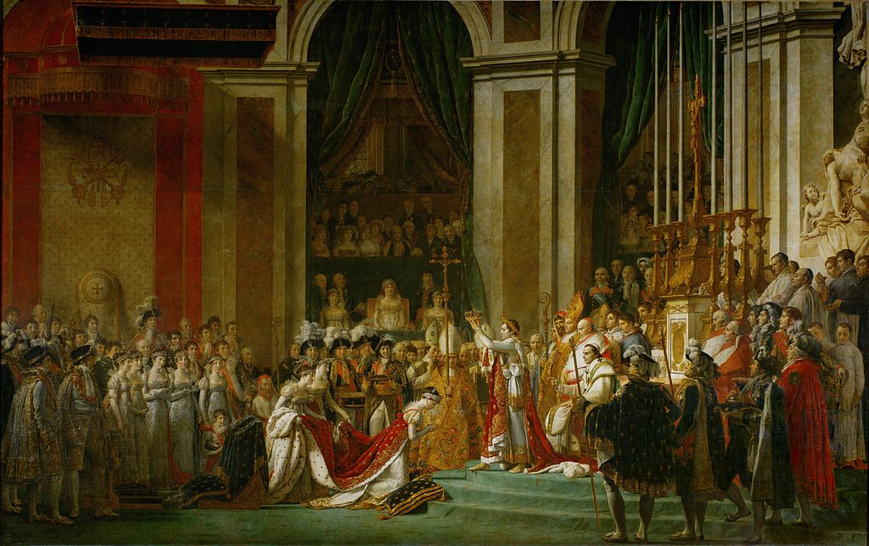
Coronation
Napoleon and his government held another election, this time for the position of Emperor of France.
He won with 99% of the vote.
On December 2, 1804 Napoleon and his wife Josephine were crowned as Emperor and Empress.

Slide 7
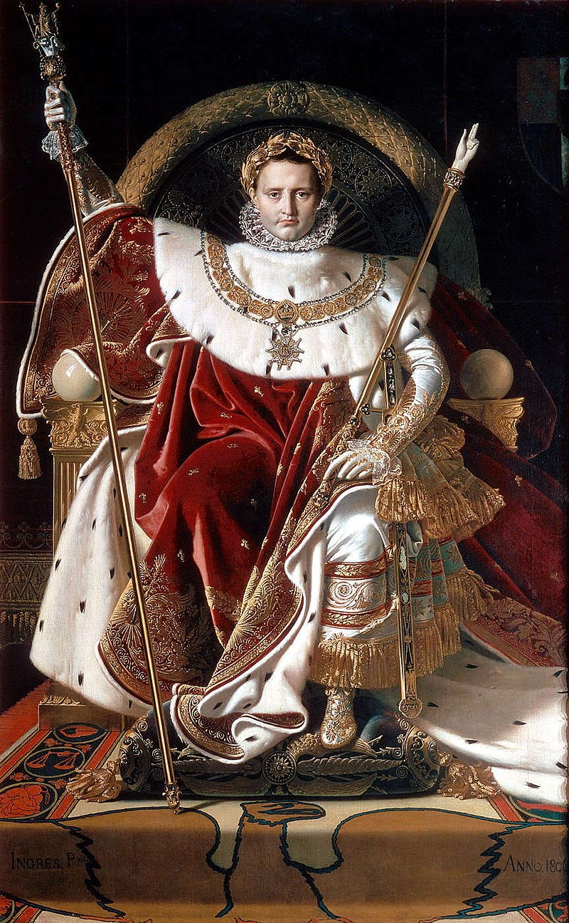
The First French Empire
Napoleon set out to expand French influence and conquer France’s enemies
He was exceedingly popular. A contemporary stated that the people supported him whole-heartedly: “people believed quite sincerely that Bonaparte, whether as consul or emperor, would exert his authority and save [them] from the perils of anarchy.”

Slide 8
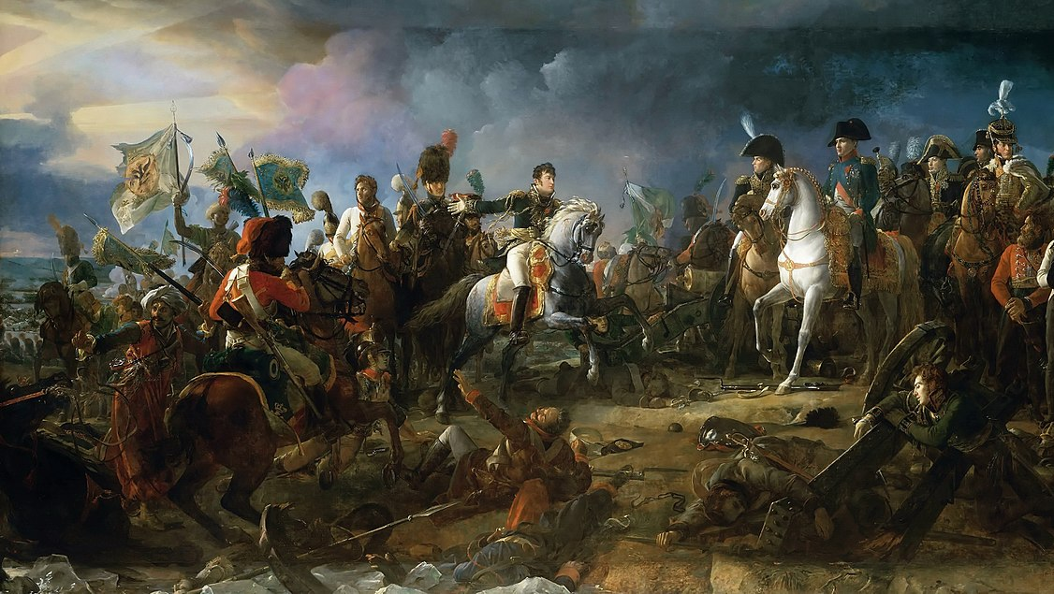
The War of the Third Coalition
In 1805, fearful of Napoleon’s rise to power, Britain, Austria (who had already been beaten twice by Napoleon) and Sweden signed a treaty and established the Third Coalition
In response, Napoleon planned an invasion of Britain (which never actually happened). In order to do so, Napoleon set about attempting to lure the Royal Navy away from the English Channel

Slide 9
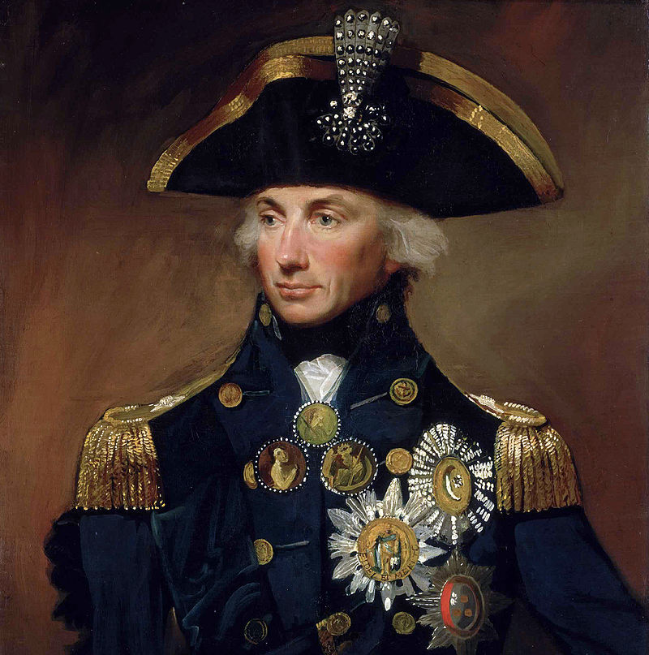
Trafalgar
Britain’s navy was the greatest in the world
On October 21, 1805 Napoleon’s navy engaged with the British Navy, led by Admiral Horatio Nelson on the HMS Victory
The battle took place off the coast of Cape Trafalgar, Spain and solidified Britain’s naval supremacy
During the battle, Nelson was shot and killed but not before he stated his most famous line: “England expects that every man will do his duty.”

Slide 10
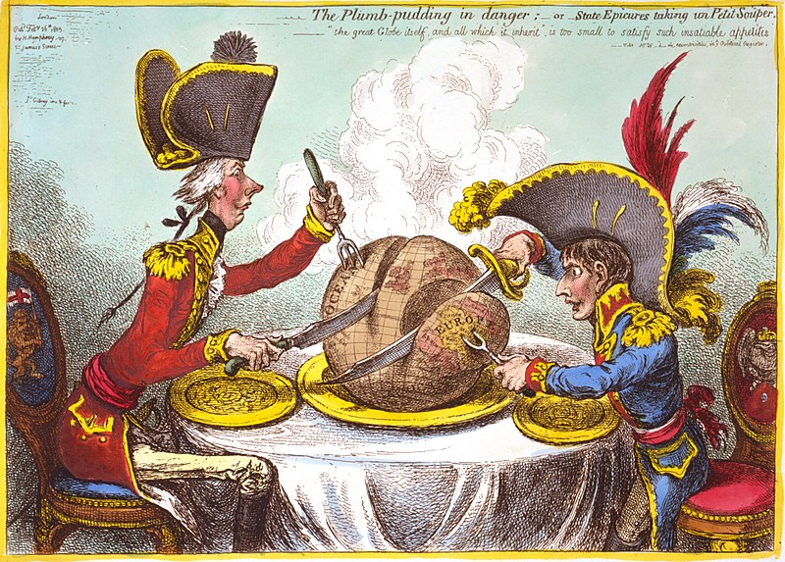
France Triumphant
In 1805, Napoleon achieved stunning victories against the Coalition at the Battle of Ulm and the Battle of Austerlitz
  This battle is considered one of the greatest battles in history
  The Third Coalition was defeated as a result

Slide 11
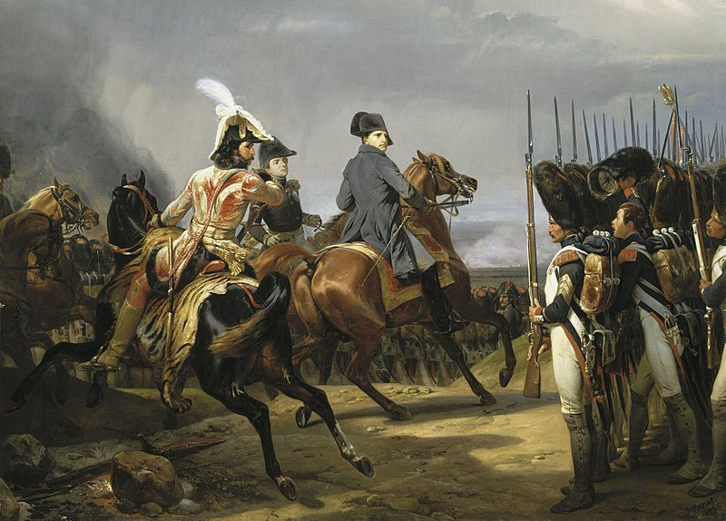
The War of the Fourth Coalition
Post-war, Napoleon reorganized the German states and established the Confederation of the Rhine, consisting of states loyal to him
Worried about Napoleon, Prussia challenged the French and were soundly beaten at the battles of Jena and Auerstedt
Russia marched into Central Europe and Napoleon defeated them in 1807
Russia made peace with Napoleon before France could attack the Russian heartland

Slide 12
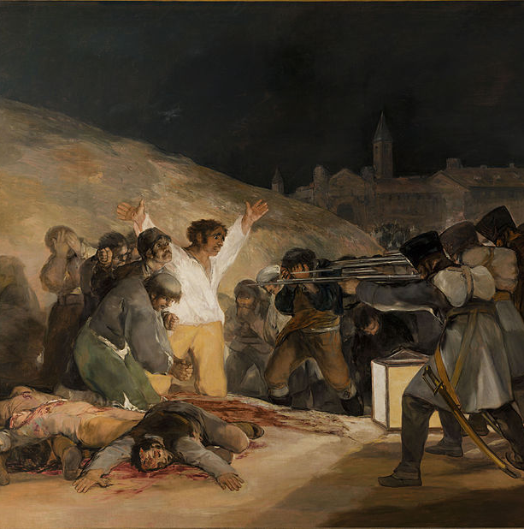
The Peninsular Wars
Napoleon next turned his eyes towards Spain
In 1808, Napoleon took over Madrid and placed his brother, Joseph Bonaparte, on the Spanish throne
Horrified, the Spanish population resisted with the support of Portugal and Great Britain
The Peninsular Wars were fought between 1808-1814 and drained France of energy, men, and money

Slide 13
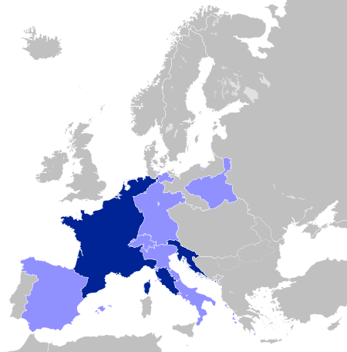
Napoleon’s Empire
By 1812, Napoleon controlled much of Western Europe
He had conquered much of this land in only ten years and had run roughshod over the German states and Italy
Even though he had attempted to invade British, the power of the Royal Navy stopped the French navy from leaving French ports
When Napoleon ended European trade with Britain, the British blockaded their ports as well
This meant Europe could not trade with anyone and led to higher prices for necessary goods

Slide 14
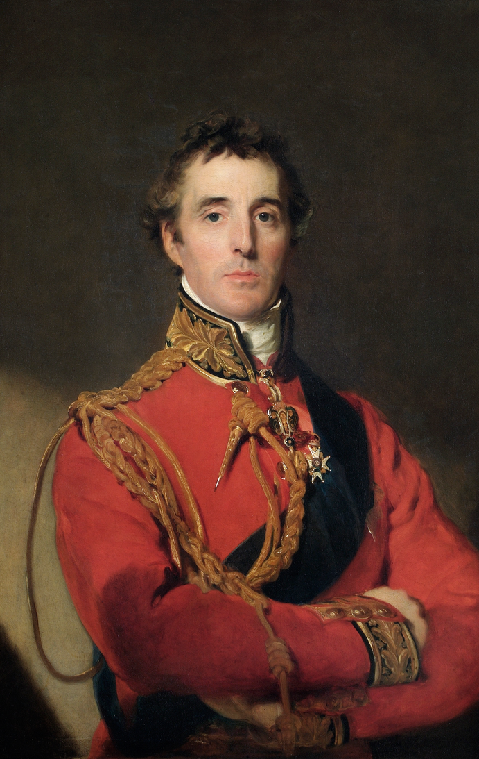
British Intervention
Napoleon left Spain to deal with Austria in 1809, but his troops continued to battle
Britain, determined to see Napoleon defeated, sent an army under the Duke of Wellington
The war devolved into guerilla warfare with both sides committing atrocities
French troops began to withdraw in 1812, however they did not withdraw completely until 1814

Slide 15
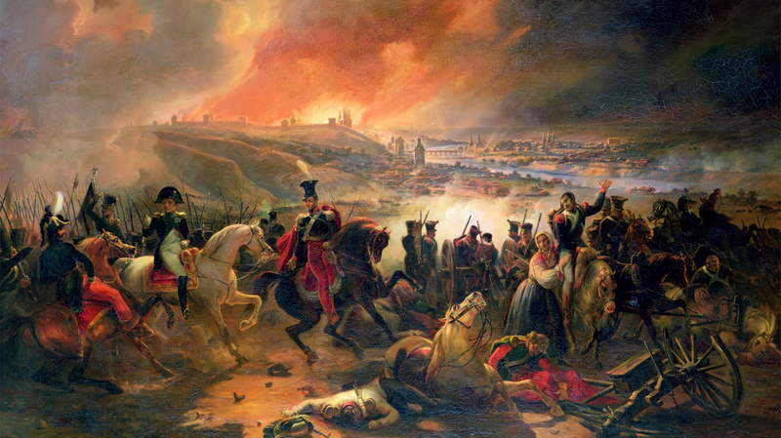
The Invasion of Russia
In 1812, Napoleon decided to invade Russia because Tsar Alexander I had traded with the British
Against all advice, Napoleon invaded the Russian heartland
The Grande Armée was defeated by Russia’s scorched earth tactics and the unbearable Russian winter

Slide 16


Slide 17
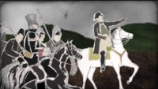

Slide 18
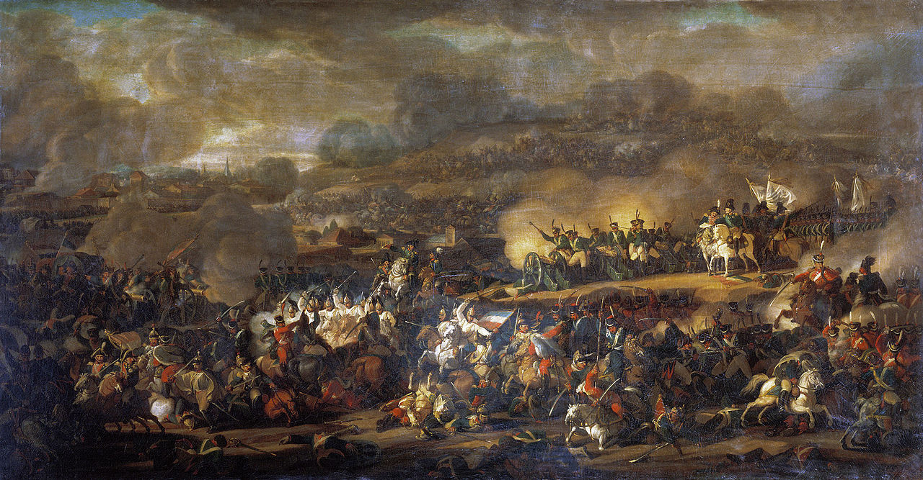
War of the SIXTH Coalition
After the Russian defeat, Russia, Prussia, Austria, Sweden, Russia, Great Britain, Spain, and Portugal decided to ally against Napoleon AGAIN
Napoleon suffered defeat in battle at Leipzig (where 90,000 men lost their lives on all sides). This was the largest battle of the Napoleonic Wars and was Napoleon’s first defeat in battle
After the battle the coalition invaded France in 1814

Slide 19
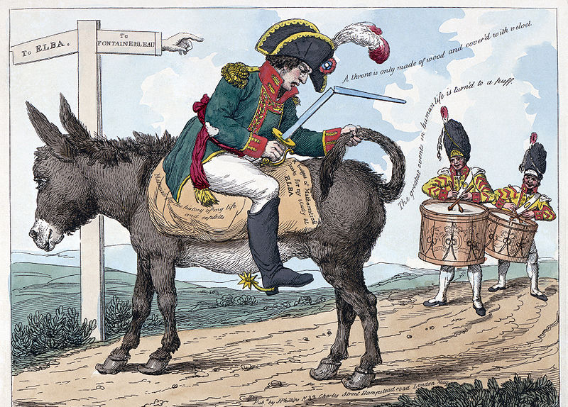
Exiled to Elba
Napoleon was surrounded and in April 1814 he abdicated his throne and was exiled on the Island of Elba, off the coast of Tuscany
In the first few months on Elba he created a small navy and army, developed the iron mines, oversaw the construction of new roads, issued decrees on modern agricultural methods, and overhauled the island's legal and educational system

Slide 20
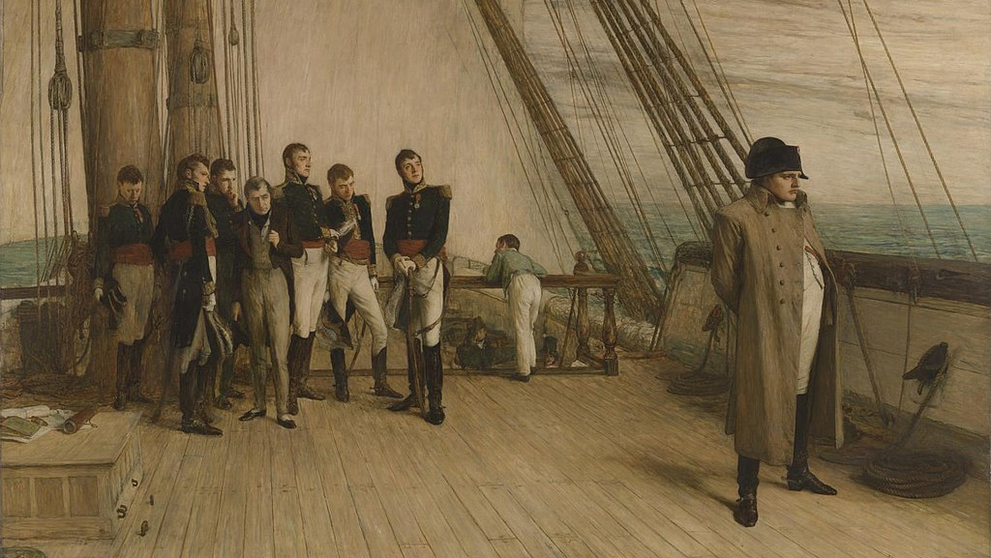
The Hundred Days
Napoleon escaped from Elba in February 1815 with 700 men and managed to re-takeover France
When met with the French army he declared: "Here I am. Kill your Emperor, if you wish“ The troops put down their weapons and joined him
For one hundred days, he was emperor again and sought to reconquer his empire

Slide 21
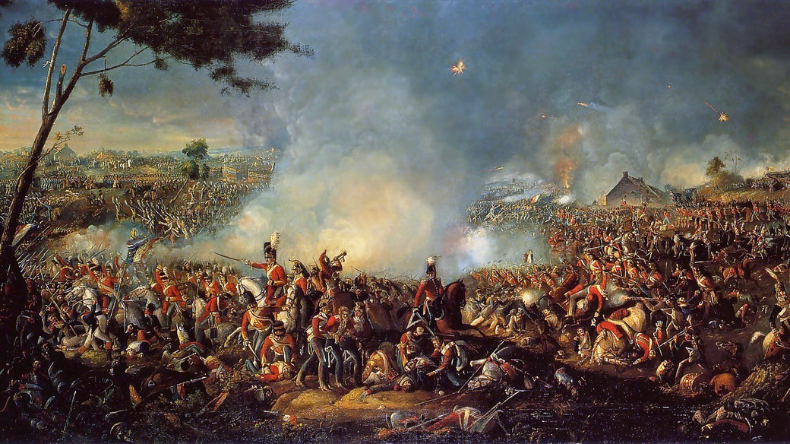
Waterloo
Napoleon’s army was finally destroyed for good at the Battle of Waterloo on June 18, 1815
The Seventh Coalition led by the British Duke of Wellington and the Prussian Prince of Wahlstatt
This battle became semi-legendary and permanently ended Napoleon’s ambitions

Slide 22
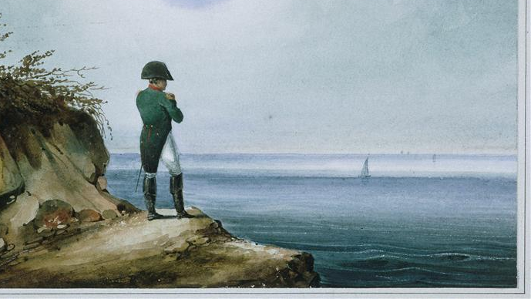
Exile to St. Helena
The British kept Napoleon on the island of Saint Helena in the Atlantic Ocean, 1,162 miles from the west coast of Africa
They even stationed a military garrison on Ascension Island to ensure that, if Napoleon escaped Helena, he would not be able to reach Europe
He died May 5, 1821

Slide 23
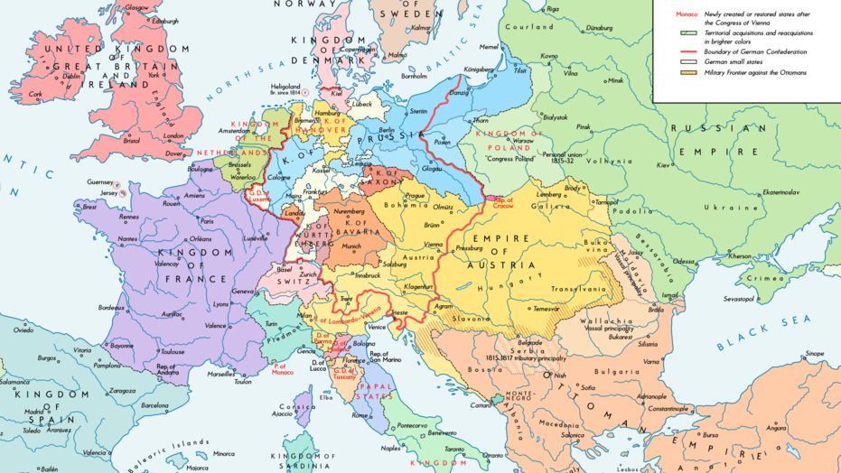
The Congress of Vienna
Met between November 1814 and June 1815 and chaired by Klemens von Metternich
The Congress’s goal was European peace and stability
It changed European diplomacy and provided a framework for how Europe was supposed to “work” that would exist until World War One

Slide 24


